Slide 1
Vision & Strategy
2
0
2
0
Tri- Nations Darts Ltd Business Plan & Presentation

Slide 2
Evaluate our current position
We Cannot Change History
We Can shape the future

Slide 3
Consider Your alternatives

Slide 4
We Cannot Change History
British Darts Organisation
Brand
Finance
Optimism
Confidence
Negative
Unsustainable Financial Loses
Loss of any kind of support
At all time low

Slide 5
British Darts Organisation
Brand
The BDO brand’s reputation has suffered irreparable damage especially in the last 12 months in the National Press and Network TV Outlets

Slide 6
British Darts Organisation
Finance
The companies assets have suffered a catastrophic downturn from a £90,000 Profit in 2018 to a £432,000 loss last year.
“ Quote from the filed accounts at companies house by our accountant”
The company has incurred significant loses to 31st May 2019, and has incurred further loses in the period since which puts doubt on its ability to continue as a going concern

Slide 7
British Darts Organisation
Confidence
The confidence in the company is at an all time low.
WHY
World Masters
World Pro
Manipulation of playing rules
Reduction of Prize Fund
Not Honouring Players Contracts
Resulting in withdrawal of World Darts Federation Recognition

Slide 8
Is there hope for the future
British Darts Organisation
Optimism
But Consider
There has been a complete breakdown of any sort of communication from the Board of Directors because:
Players have no confidence in our (The BDO) product.
They have no confidence in the BDO Diary
They have no confidence that events or prize monies will be staged or honoured.
They have no confidence that outstanding invoices can be paid.
They have no confidence that the company can continue to trade at any level
There is no confidence anywhere in the market place.
There is no confidence that the company can move forward or even survive.

Slide 9
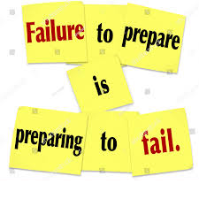
We Can shape the future
But

Slide 10
Tri- Nation Darts Ltd Business Plan

Slide 11
Tri-Nations
Business Plan will provide
Purpose
Desire
Drive
Initiative
Aspirations
Enterprise

Slide 12
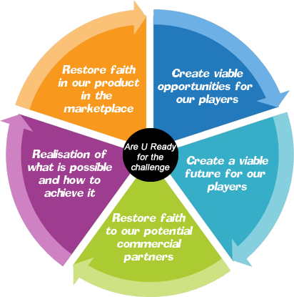
The Future with Tri- Nations Darts Ltd

Slide 13
Shaping the future
All Counties will have to be members of the Tri-Nations which will mean they must register with their own National Organisations England Darts - Welsh Darts -Scottish Darts.
Note:
a) The new Tri-Nations Inter-Counties, will adopt the same fees and rules structure currently within the BICC.
b) No Money can be paid into the Tri-Nations as currently there is no bank account set up. c) We will require an E-mail by counties confirming commitment of intent to analyze support for this initiative.
d) The Tri-Nations cannot progress without the counties full commitment to being members of the Tri-Nations
The Tri-Nations intend to run :
Super League
Inter - Counties leagues
Gold Cup (singles and Pairs)
. Champions Cup (Super League Champions)
The company intends to seek sponsorship which will come into the company and in turn it’s members
Their will only be one company, with one set of accounts, which will be an in-depth analysis of the total business.
The company will cover all, accountancy, insurances and running costs.
No directors will be paid directly or indirectly, apart from expenses.
There has been a comprehensive analysis of the actual costs involved, including prize funds.
There will be a County player registration fee per player.
We will not be extending the company towards managing/organising World events.
This proposal is non-negotiable and is a take it or leave it scenario, we are prepared to invest our time and effort into turning the business around, and creating a brighter and sustainable future on behalf of the membership.

Slide 14
Tri-Nations Darts Ltd Members
England
Scotland
Wales
Countries Owned by their County Members
Tri-Nations Darts Ltd 3 Equal Shareholders
Tri-Nations Darts Ltd Directors
England (2)
Scotland (2)
Wales (2)
6 Directors to be ratified by each countries A.G.M Membership (There can be no veto on any other countries Officials)

Slide 15
The Future with Tri - Nations Darts Ltd
WDF 130 World Ranked Players Opens
WDF International Team Events
WDF World Cups
British Internationals
WDF World Championship
WDF Masters Championships
WDF Europe Cups
6 Nations Internationals

Slide 16
The Future with Tri- Nations Darts Ltd
The Executive of Tri-Nations Darts Ltd Would like to thank you all for taking the time to view our vision. You may choose to take a different path! Tri-Nations Darts offers you a sustainable opportunity for the future!

